Slide 1
Trainify eCall Agents
Rashmi, Pavel, Hoa, Prashanth, Johannes
Notes:
Hi, I’m Johannes from Bosch eBike Systems, and together with my Team we tackled a topic which literally saves millions of lives every year.
Getting into a car or motorcycle accident is annoying at best, and lethal at worst. But thanks to Bosch eCall, we can at least be sure that we are getting the best possible support in case of an emergency.

Slide 2



eCall
Trainify
We received an emergency call – What happened?
I just had a motorcycle accident
Notes:
If you are in an emergency, your vehicle calls emergency service for you. You get connected with experts that can help you out and forward all relevant information to medical support if necessary.
The automatic emergency calling is mandatory for newly sold vehicles from 2017 on. In 2021, our eCall system passed the 1 Million user mark.
As you can imagine, there is a high level of skill needed for the callcenter employees to be able to receive all relevant information from the victims while also calming them down and give instructions in what to do.
I remembered when I got in an emergency and it’s crazy how the brain shuts down and you loose the abililty to clearly express yourself.
So in order to save lifes reliably, these callcenter employees need frequent training.
…No actually we are relying on trainers that have scripts for roleplay or come up with cases sponteneausly, if they are creative.
But this is not only time consuming and not scaleable, and it also requires trainers that speak the language of the trainee.

Slide 3

Trainify
Multi-Agent first responder training
Notes:
This is where our solution Trainify comes into play.
Advancements in transformer models and text to speech enabled us to build a multi-agent tool to train and score first-responder performance in real time
Our tool is basically a simulator for emergency calls.

Slide 4



Our Strengths
Trainify
Cost Efficient
Scaleable
Multi-language
Instant Feedback
Notes:
It is cost efficient and scaleable like no other solution, since there is no one to one training needed.
And not only that, since no trainer or reviewer is needed, it can also provide new use cases on every run, preparing first-responders for a variety of different situations
For todays demo, Trainify can speak english, but the tech stack is currently capable to easily expand to 30 languages.
After each call, the user is provided with scores in different categories along with an easy to understand suggestion on what the first-responder did well, and which areas they need to focus on. The instant personalized feedback has been proven to maximize outcomes in learning situations.

Slide 5
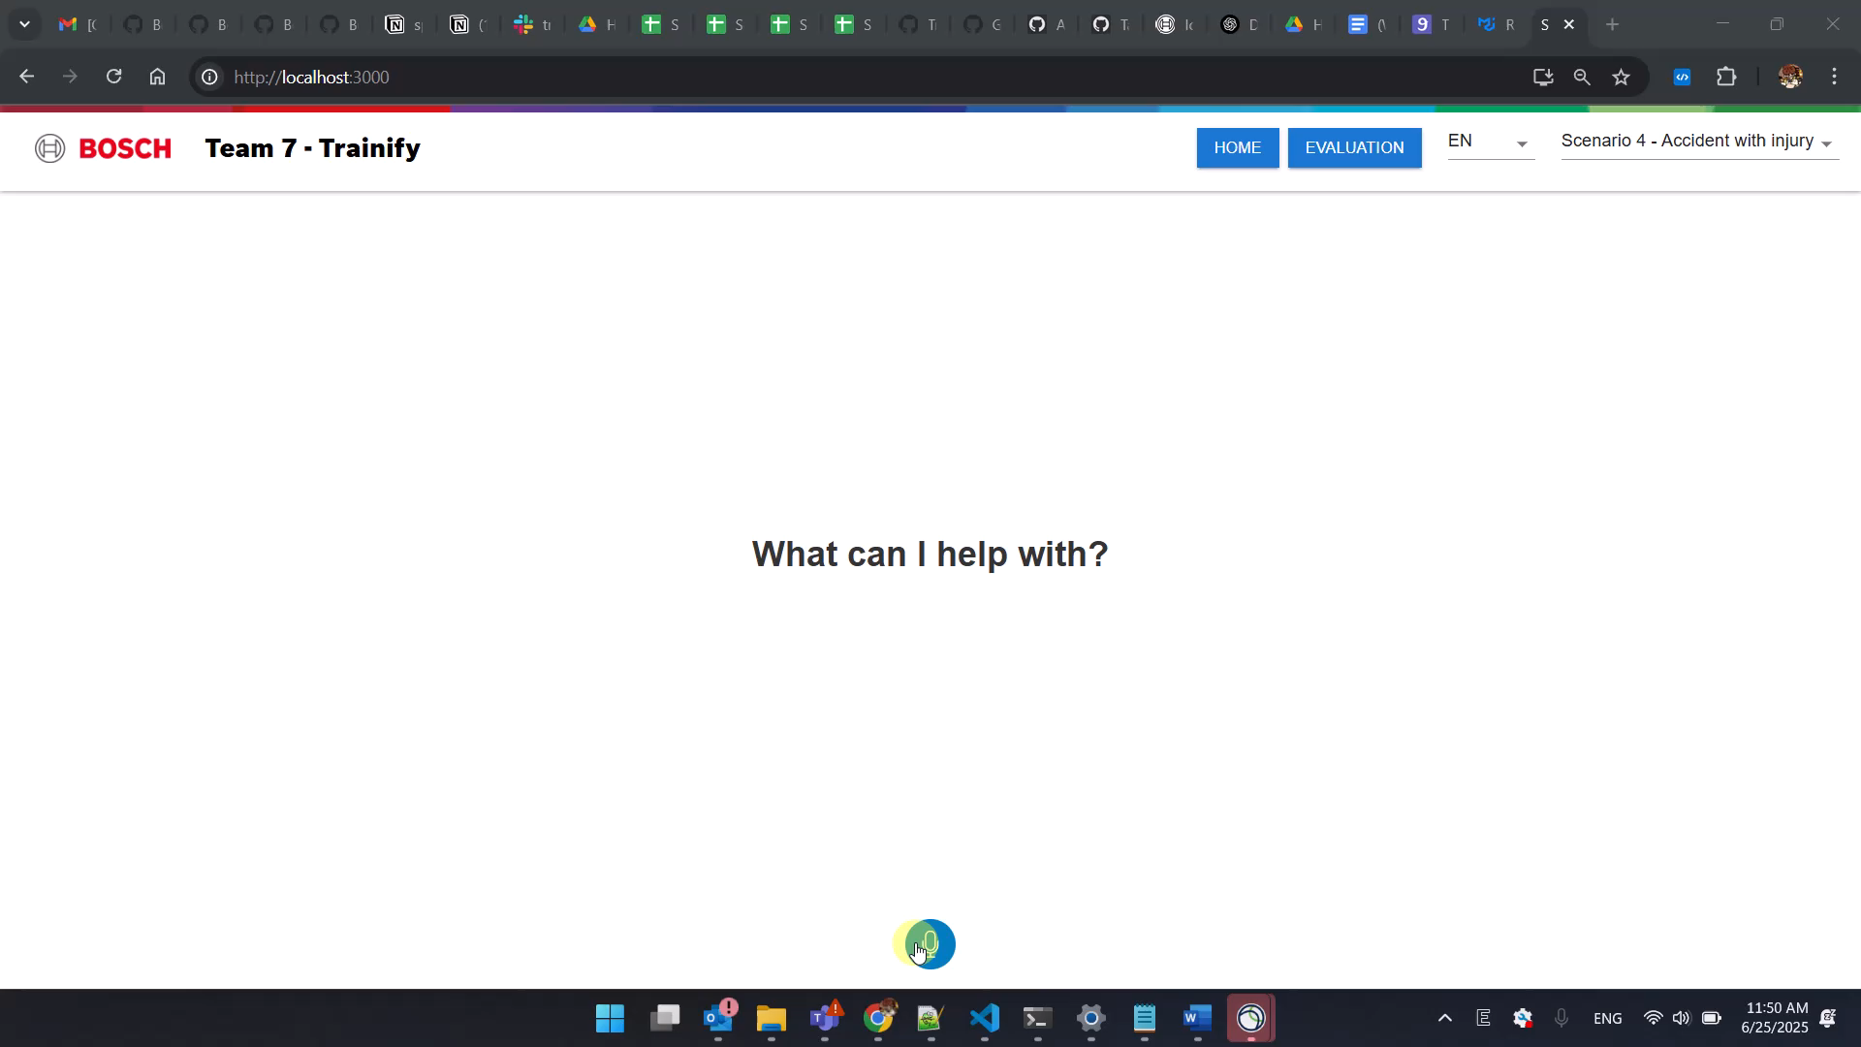
Demo Time!
Notes:
Let’s take a look on what we cooked in the last 24 hours.
You can see, our prototype frontend is very minimalistic right now. You have the micorophone button to start talking and greeting the victim of the accident.
The conversation is transcribed live and stored, so it can be revisited later on.
When the call is finshed, the user gets provided with an evaluation. They can see what they did well and on which areas they need to improve.

Slide 6










Architecture
Trainify
Trainee
Victim Agent
Evaluation Agent
Coach Agent
Notes:
Let’s take a look at how it works under the hood.
For the frontend we used React.
We used n8n as an orchestrator since it was the easiest way to plug everything together.
When the user starts talking, the audio is send to elevenlabs for transcription.
The transcript is forwarded to Gemini 2.5 Flash for quick high quality responses.
We developed system prompts to be able to play different personas for different cases of accidents.
The output of Gemini is then again send to Elevenlabs for text to speech.
Elevenlabs has proven to provide high quality realistic sounding voice output.
We are even able to make the voice sound nervous or panicked, but since this is an alpha feature the quality of the voice is still improving.
We are sure we will be able to generate realisticly paniced sounding voices in the future.

Slide 7
Next Steps
Trainify
Emergency Service forward simulation
Improve tonality of accident victims
Tonality evaluation

